Slide 1
ECG Based Authentication
Handbook of Information and Communication Security, Springer 2010 (Book Chapter)
Authors – Fahim Sufi, Ibrahim Khalil, Jiankun Hu
CSE 6811 – Wireless Ad Hoc Networks
Presented By –
Nafis Neehal (0415052110)
Dewan Ziaul Karim (0417052119)
Sejuti Banik (0417052004)

Slide 2

Electrocardiogram (ECG) Signals are now one of the emerging techniques for Biometric Authentication

Slide 3
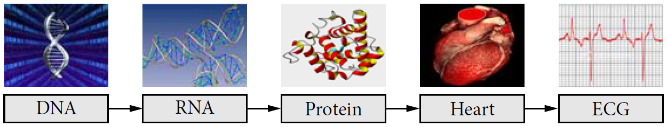
Biometric Systems and Inheritance of ECG
Biometric System – Template Matching
Acquired biometric data
Template Data
Several ways – DNA, Iris, Fingerprint, Retina, Voice etc.
DNA - One dimensional ultimate unique code for a person
ECG - Graphical record of the electrical impulses of the heart
ECG based biometric – A recent research topic

Slide 4

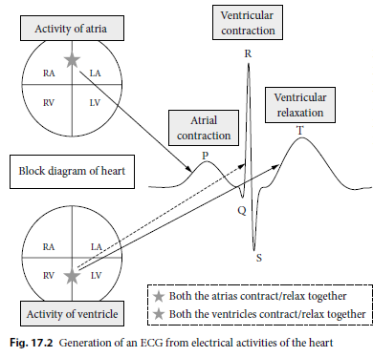
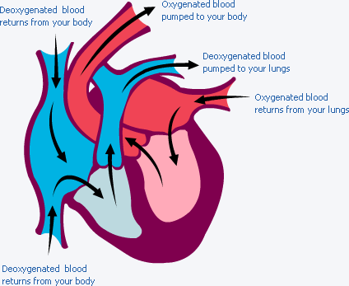



Physiology of ECG
Superior vena cava
P wave
T wave
Right atrium
Left atrium
QRS complex
Inferior vena cava
Left ventricle
Right ventricle

Slide 5
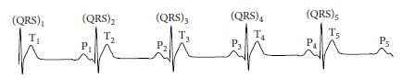
Feature Waves & Rhythm Analysis
Width
A normal QRS complex 0.06–0.10 sec (Represented by 3 square boxes)
PR interval - 120–200ms (3-5 boxes)
Amplitude
Read in millivolt range
Dependent on the sensitivity of ECG sensor
Direction and curvature
Feature set, F = P_{m} U (QRS)_{m} U T_{m} , where ,
Pm = {P₁, P₂, P₃, P₄, P₅},
(QRS)m = {(QRS)₁ , (QRS)₂ , (QRS)₃ , (QRS)₄ , (QRS)₅ },
Tm = {T₁, T₂, T₃, T₄, T₅}
RR_{u} = time of occurrence(QRS)_{m} − time of occurrence(QRS)_{m} ₋ ₁
IHR =60/RR₁, 60/RR₂, 60/RR₃, . . . ,60/Rr_{u}
HRV is the beat-to-beat alterations in heart rate

Slide 6
ECG Biometrics Usage & Classification
Verification ECG (One to One matching)
PIN or name or smart card to identify himself and his acquired ECG is matched (one-to-one matching) with his own ECG template
Identification ECG (One to Many matching)
An individual’s biometric ECG is recorded and template matching is performed throughout the ECG template database.
ECG Biometrics Classification
Fiducial Point detection (Time Series Data) | ECG features extracted in the frequency domain

Slide 7
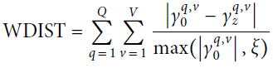
Modern ECG Biometrics Classification
Direct Time Domain Feature Extraction
ECG Morphology (P duration, P amplitude, QRS duration, QRS amplitude, T duration, T amplitude, etc.)
Uniqueness of Beating Patterns (Patterns of consecutive hear beats. RR interval, IHR and HRV, breathing patterns)
ECG Morphology - Most primitive form of ECG features
Frequency Domain Feature Extraction
Wavelet Decomposition
Fourier Transform (stethoscope to obtain the Lubb–Dubb sound of heart)
Discrete Cosine Transform (DCT)

Slide 8
Modern ECG Biometrics Classification
Other Approaches for Feature Extraction
Statistical Approaches
Percentage Root-Mean-Square Difference (PRD)
Measure the quality of reconstructed ECG after lossy ECG compression
Cross Correlation (CC)
Technique used in statistics to match the similarity of signals
Least Discriminant Analysis (LDA), Autocorrelation and Mean–Variance of RR interval
Neural Network
Template matching algorithms along with
Decision Based Neural Networks (DBNN)
Obtain 100% accuracy (experimented on 20 subjects)
Polynomial Based
Extract polynomial coefficients from ECG signal
Coefficients used as biometric templates

Slide 9
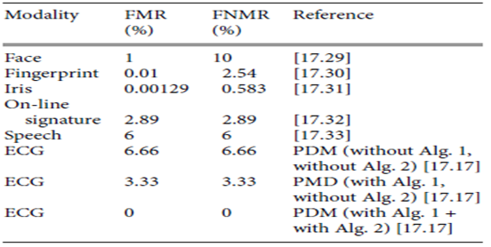
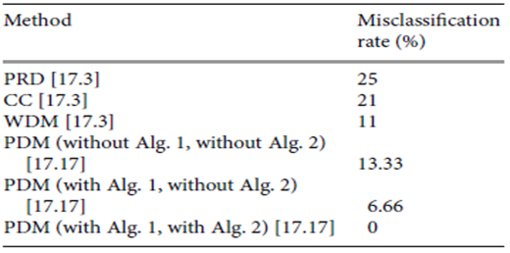
Comparison of Existing ECG Biometric Systems
Misclassifications and Accuracy
Higher Misclassification Rates - PRD, CC and WDM
Lower Misclassification Rates – PDM
Misclassification reasons –
Not prioritizing the ECG features
Occurrence of abnormal beats
Two algorithms solved these issues
FMR - Chances of a wrong person’s (different) enrolment data being matched against the recognition data provided
FNMR - Reflects the occurrences of the same person’s enrolment data and recognition data not being similar
Misclassification rate for PRD,CC,WDM and proposed PDM
FRM and FNRR across different modalities

Slide 10
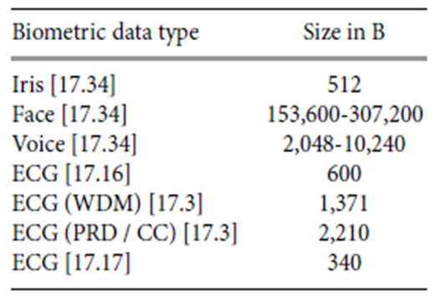
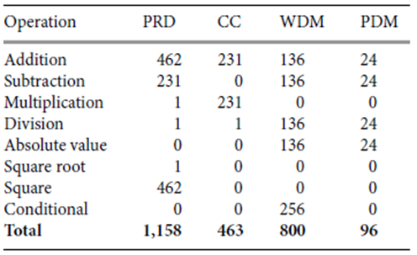
Comparison of Existing ECG Biometric Systems
Template Size
Computational Cost
Based on number of operations needed to compute
similarity matching between the enrolled data and
recognition data
Comparison of template sizes
Comparison of number of operations (NOP)
for PRD, CC,WDM and PDM

Slide 11
System Design of ECG Biometric
Enrolment: ECG template x_{u} (5 heart beats) is enrolled into system
Verification:
After enrolment: a. System takes input of individual ECG y_{u} b. Matches y_{u} with x_{u} using S_{j} (through PRD, CC and WDM) c. if result of function S_{j} is within threshold Γ_{j}, then A(I, y_{u}) returns A₁ else A(I, y_{u}) returns A₂
User Initiated: 1. User inputs identification data e.g. name, Pin etc. along with verification data y_{u} 2. Corresponding ECG x_{u} is fetched from template database 3. Finally S_{j}(x_{u}, y_{u}) performs necessary calculations as steps b and c of the after enrolment procedure.

Slide 12
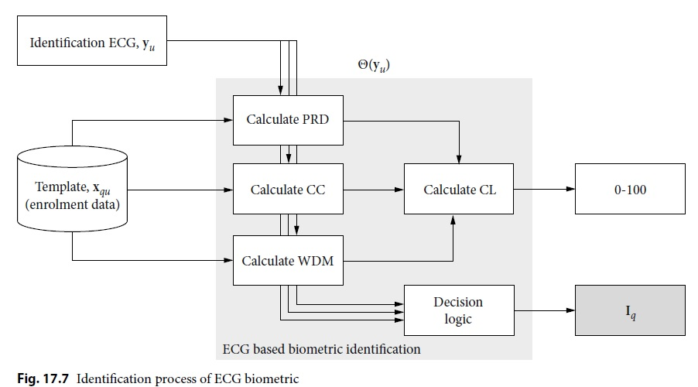
System Design of ECG Biometric
Identification:
Confidence Level, CL = 0.25X(100-PRD)+ 0.25X(100-CC)+ 0.5X(100-WDM)

Slide 13
Difference Between Verification and Identification
The difference lies in the Decision Logic
B: PRD ≤ 14
C: CC ≥ 0.03
D: WDM ≤ 6
E: WDM ≥ 69.25
G: Person Recognized (Verified/Identified) .
Decision Logic for Verification | Decision Logic for Identification
G → B ∩ C ∩ D ∩ E | G → (D ∩ E) ∩ (B ∪ C)

Slide 14
Software Implementation of ECG Biometric
Finding Threshold Γ_{j}:
2 ECGs each for 15 MIT-BIH people were acquired over a duration ( 1 week-month)
Matlab scripts for automating
For all cases PRD < 13.3 (<14), CC > 0.0351 (>.03) and WDM < 5.4 (<6)
Samples were also randomly cross checked for efficient threshold determination of threshold
Environment, Database and Dataset:
.net and MS Visual Studio 2005
SQL Server
Publicly available ECG data

Slide 15
Software Implementation of ECG Biometric
Methodology:
“Identify Person” option matches sample with all templates in SQL server
The highest match (with highest CL value) fetched from the database
Name Picture and Recognition Data shown on the software screen.

Slide 16
Open Issues of ECG Based Biometric System
Lack of Standardization of ECG Fiducial Points no exact location where the ECG feature wave boundaries lie minute variation in fiducial point position leads to misclassification in the substantial population domain
Time Variant Nature of ECG ECG tends to change under different physiological condition and time Solution: Body Sensor Network for synchronized heart rate monitoring
Pertinence of Random Abnormality in ECG Unable to work with ectopic or premature beats (abnormal and random)
Longer Duration for ECG Wave Acquisition Previous applications take upto 20s time to average 20 beats Not feasible for time critical systems
Longer Duration for ECGWave Acquisition size of ECG template 600B. But some algorithms take O(n²) with many features.
Lack of Experimental Data for Verification At least two sets of normal ECG data acquired over a moderate time interval is necessary. Available data were from hospital and even after ethical approval Very recently, ECG Wave Information provide large sets of ECG data

Slide 17
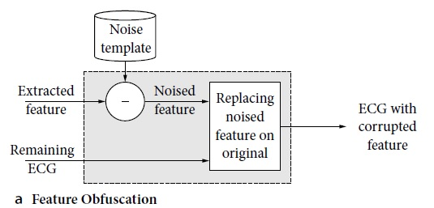
Security Issues for ECG Based Biometric
ECG Encryption a. specialized permutation cipher (character shuffling) b. Key only to authorized personnel
ECG Anonymization a. Wavelet Decomposition to know Frequency and Time Domain b. Corrupting first one of wavelet coefficients
c. Combining all coefficients to recreate anonymized ECG
ECG Obfuscation
Fig: Part of Fully encoded ECG through mathematical Transformations

Slide 18
Our Contribution
Previous ECG applications and Systems used 7-168 data Insufficient!
Our approach deals with 50,000 data and reduces the authentication time lag

Slide 19
Identification Time Reduction in ECG Based Authentication using K-Means Clustering for Biometric Templates

Slide 20
Objective
Reduce Identification time in ECG based authentication (one to many matching)
Ensure highest possible accuracy
Ensure zero tolerance for False Positives (FMR Value / FAR) and lower rate of False Negatives (FNMR value / FRR)
Achieve optimal number of clusters

Slide 21
Literature Review [1]
ECG Compression for time reduction in Identification
They have used one-person-one-cluster technique and used multiple entries for one person and considered all the entries of one person as a single cluster. So if there are n persons, there would be n clusters which definitely would not be that much of a time reduction
Used 16 Features for each entry identification after applying dimensionality reduction from initial 157 features. Although they have achieved 100% misclassification rate, but that is in terms of FNMR, they haven’t said anything about FMR values
They have converted ECG to a compressed characterized form. The compression procedure itself would consume a significant amount of time each and every time a user wants to authenticate, but they haven’t considered it in time of performance measurement
They haven’t shown any clear run-time comparison data with other existing ECG Based Authentication methods
Nothing on optimal cluster selection (as they are considering each person’s data as one cluster)

Slide 22
Literature Review [2]
Fiducial feature reduction analysis for ECG based authentication
Applied only PCA, LDA, IGR etc. which can lead to reduction in dimension.
They haven’t done anything on clustering which might have lead to a data partition and reduction in number of entries to search

Slide 23
Proposed Methodology
ECG Signal Acquire
Fiducial Features Extraction
Data Preprocessing (Cleaning, Extrapolate, Scale)
Optimal Cluster Number Selection (Time Reduction, Accuracy, Elbow, Silhouette Score)
Repeat, Until Convergence with fulfilled Objective Maximization
Search only values in the predicted cluster
Predict Test Data Cluster
Automated Physical Data Partition (Initial Batch Enrollment) according to Cluster Values

Slide 24
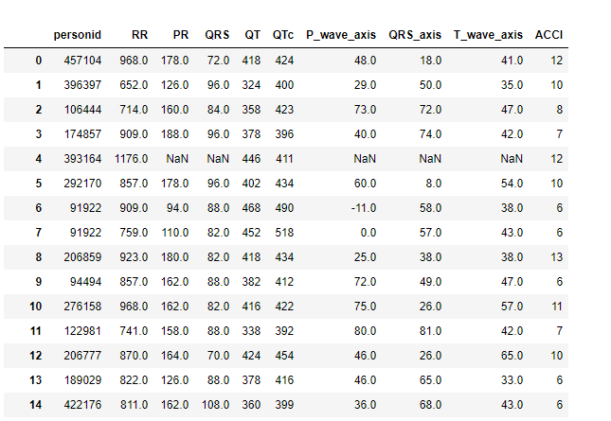
Dataset (ECG-ViEW II)
ECG-ViEW II database was used
9 Fiducial Features, namely – RR interval, PR Interval, QRS Duration, QT Interval, QTc Interval, P Axis, QRS Axis, T Axis and age-adjusted Charlson comorbidity index (ACCI) Value
Worked on Partial Data with around 50k entries
Yet to work on the full ECG-ViEW II dataset consisting of around 1 Million ECG record

Slide 25
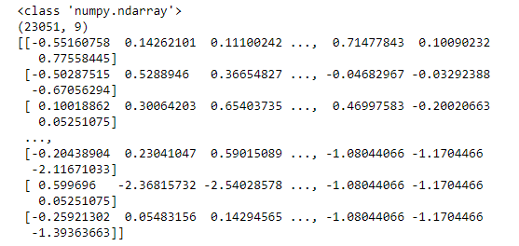
Data Preprocessing
After data was acquired, the missing values were filled with zeros.
For the users having multiple ECG enrolled, the mean of there enrollment values were taken and other multiple enrollment data were removed.
Data was rounded to the nearest integer value
Finally data was scaled and transformed using StandardScaler() – remove mean and scale to unit variance
After this stage, we had around total 23k entries

Slide 26
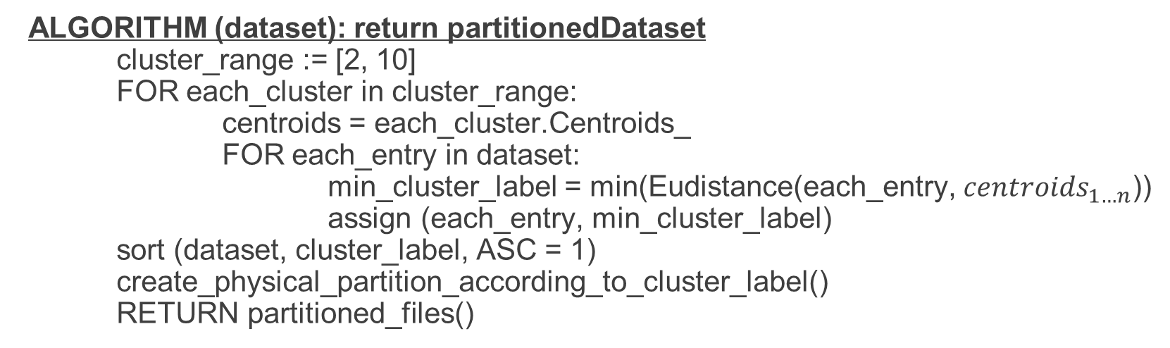
Data Clustering
ALGORITHM (dataset): return partitionedDataset
cluster_range := [2, 10]
FOR each_cluster in cluster_range:
centroids = each_cluster.Centroids_
FOR each_entry in dataset:
min_cluster_label = min(Eudistance(each_entry, ${centroids}_{1…n}$))
assign (each_entry, min_cluster_label)
sort (dataset, cluster_label, ASC = 1)
create_physical_partition_according_to_cluster_label()
RETURN partitioned_files()

Slide 27
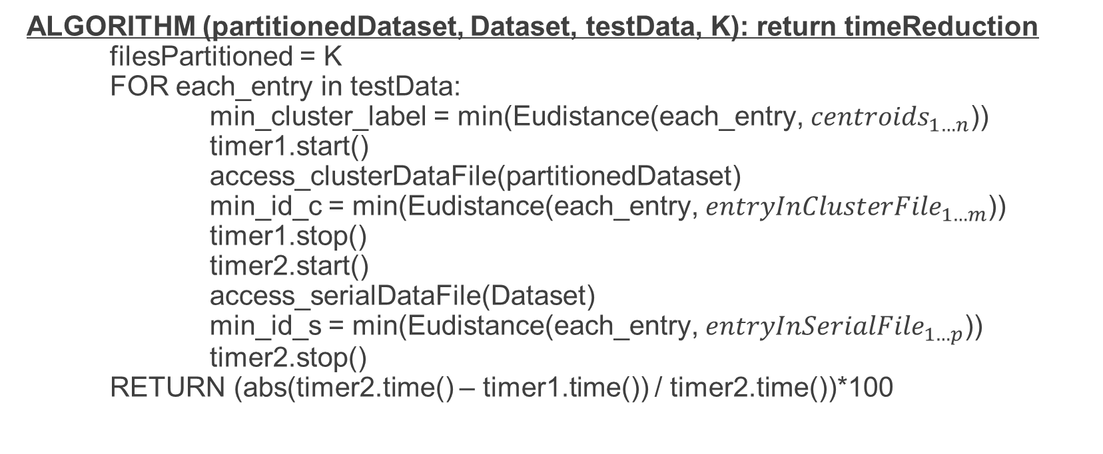
Data Identification time Reduction
ALGORITHM (partitionedDataset, Dataset, testData, K): return timeReduction
filesPartitioned = K
FOR each_entry in testData:
min_cluster_label = min(Eudistance(each_entry, ${centroids}_{1…n}$))
timer1.start()
access_clusterDataFile(partitionedDataset)
min_id_c = min(Eudistance(each_entry, ${entryInClusterFile}_{1…m}$))
timer1.stop()
timer2.start()
access_serialDataFile(Dataset)
min_id_s = min(Eudistance(each_entry, ${entryInSerialFile}_{1…p}$))
timer2.stop()
RETURN (abs(timer2.time() – timer1.time()) / timer2.time())*100

Slide 28
Performance Evaluation

Slide 29
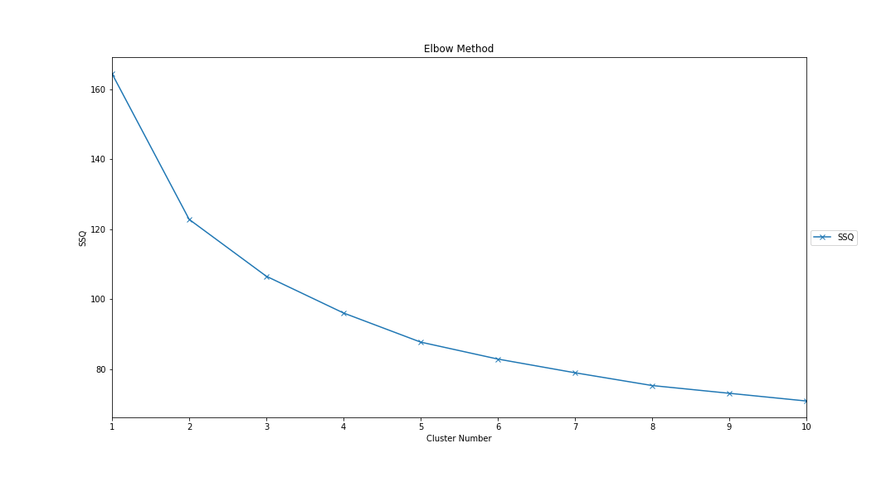
Optimal K Selection (Elbow Method)

Slide 30
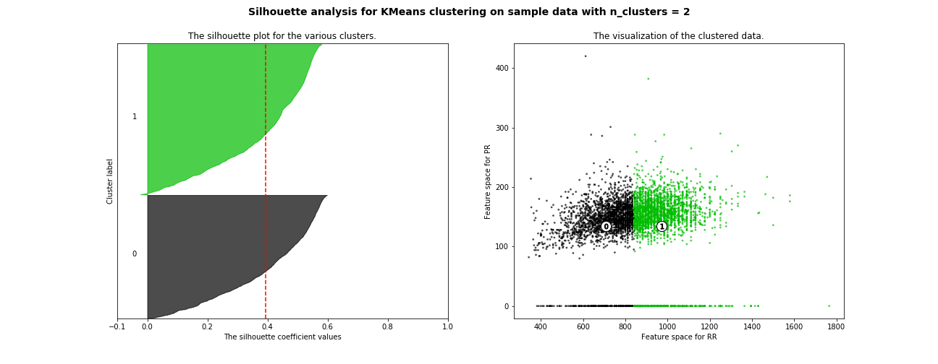
Optimal K Selection (Silhouette Score, K = 2)
Average Silhouette Score of Cluster – 0.3948

Slide 31
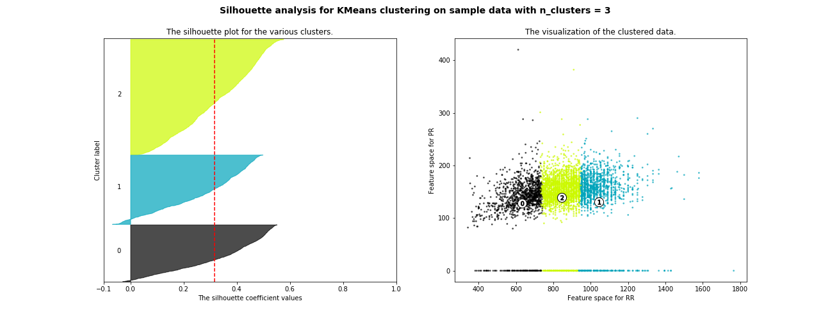
Optimal K Selection (Silhouette Score, K = 3)
Average Silhouette Score of Cluster – 0.3160

Slide 32
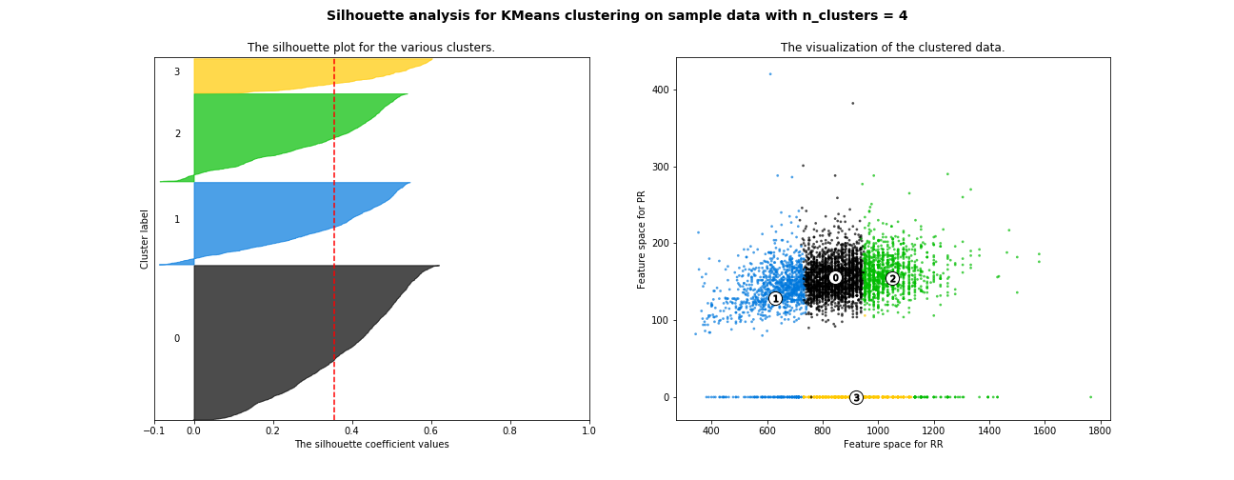
Optimal K Selection (Silhouette Score, K = 4)
Average Silhouette Score of Cluster – 0.3551

Slide 33
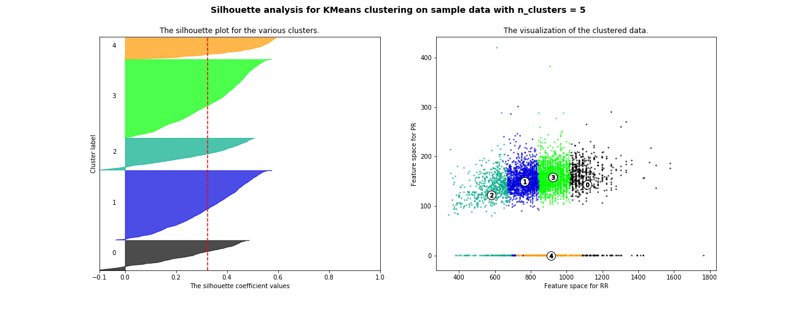
Optimal K Selection (Silhouette Score, K = 5)
Average Silhouette Score of Cluster – 0.3240

Slide 34
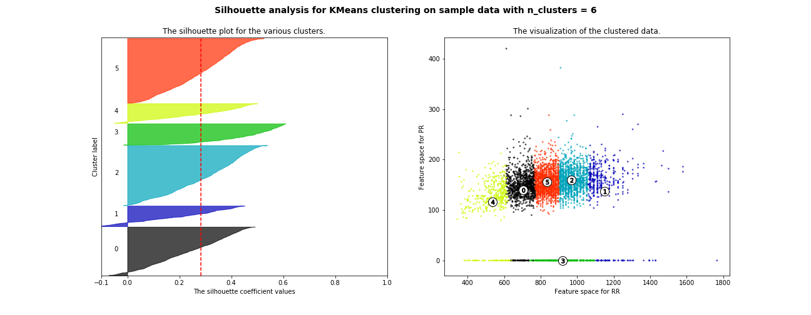
Optimal K Selection (Silhouette Score, K = 6)
Average Silhouette Score of Cluster – 0.2820

Slide 35
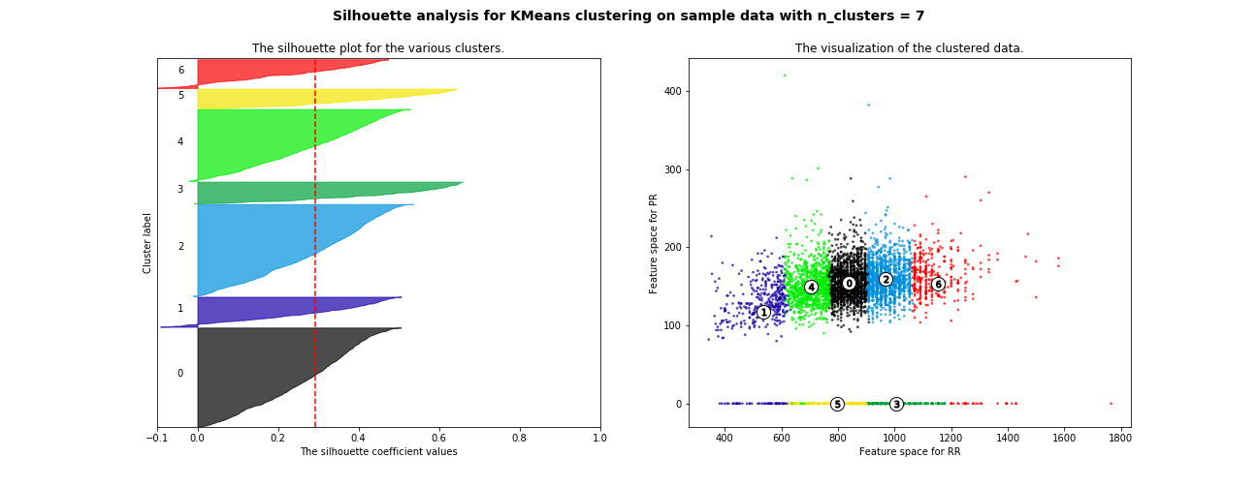
Optimal K Selection (Silhouette Score, K = 7)
Average Silhouette Score of Cluster – 0.2917

Slide 36
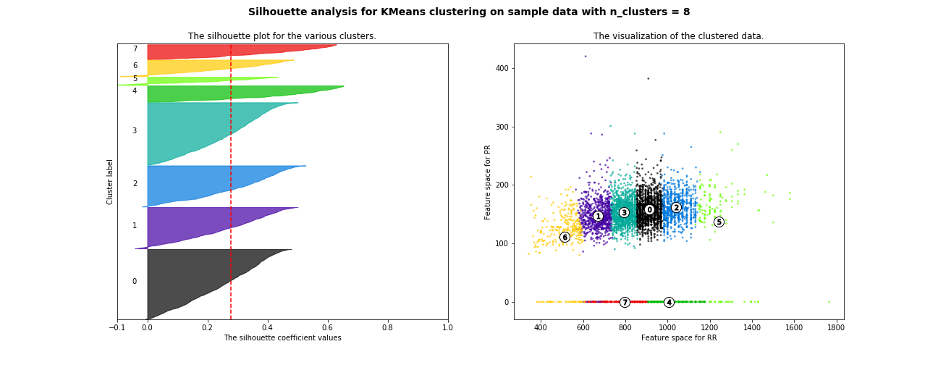
Optimal K Selection (Silhouette Score, K = 8)
Average Silhouette Score of Cluster – 0.2793

Slide 37
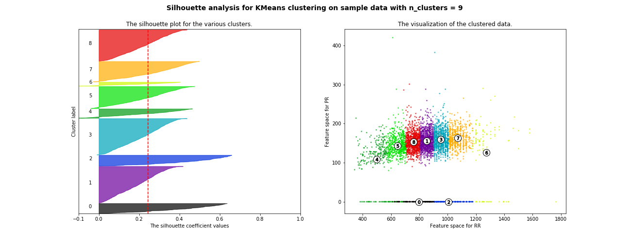
Optimal K Selection (Silhouette Score, K = 9)
Average Silhouette Score of Cluster – 0.2451

Slide 38
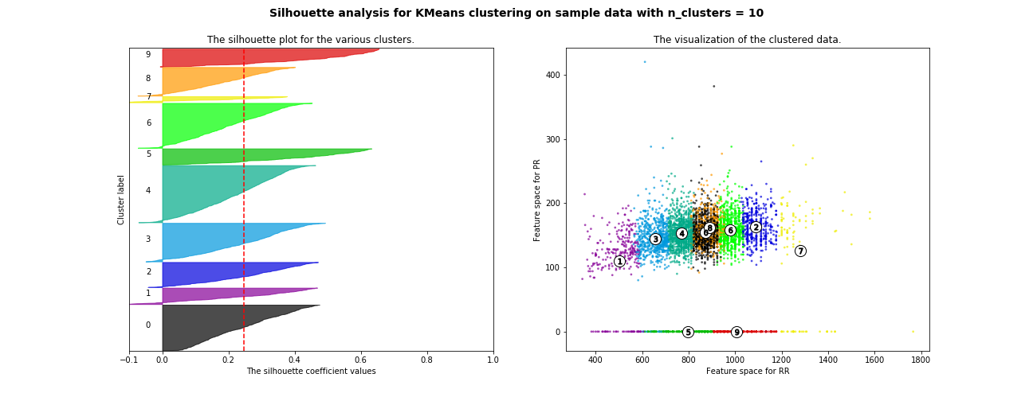
Optimal K Selection (Silhouette Score, K = 10)
Average Silhouette Score of Cluster – 0.2478

Slide 39
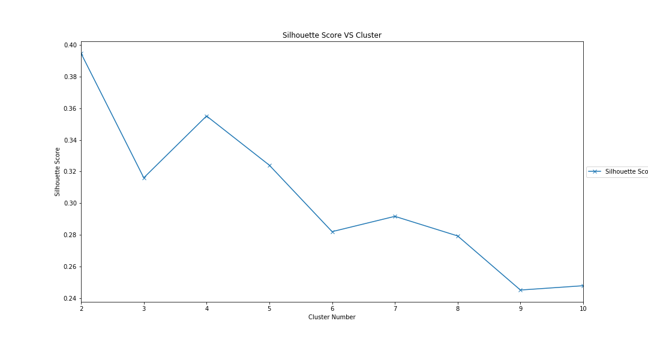
Optimal K Selection (Silhouette Score VS Cluster)

Slide 40
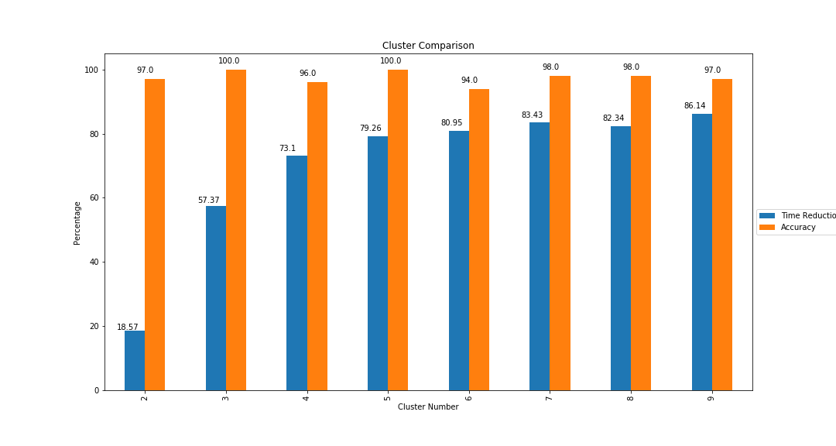
Cluster Comparison K vs (Time Reduction, Accuracy))

Slide 41
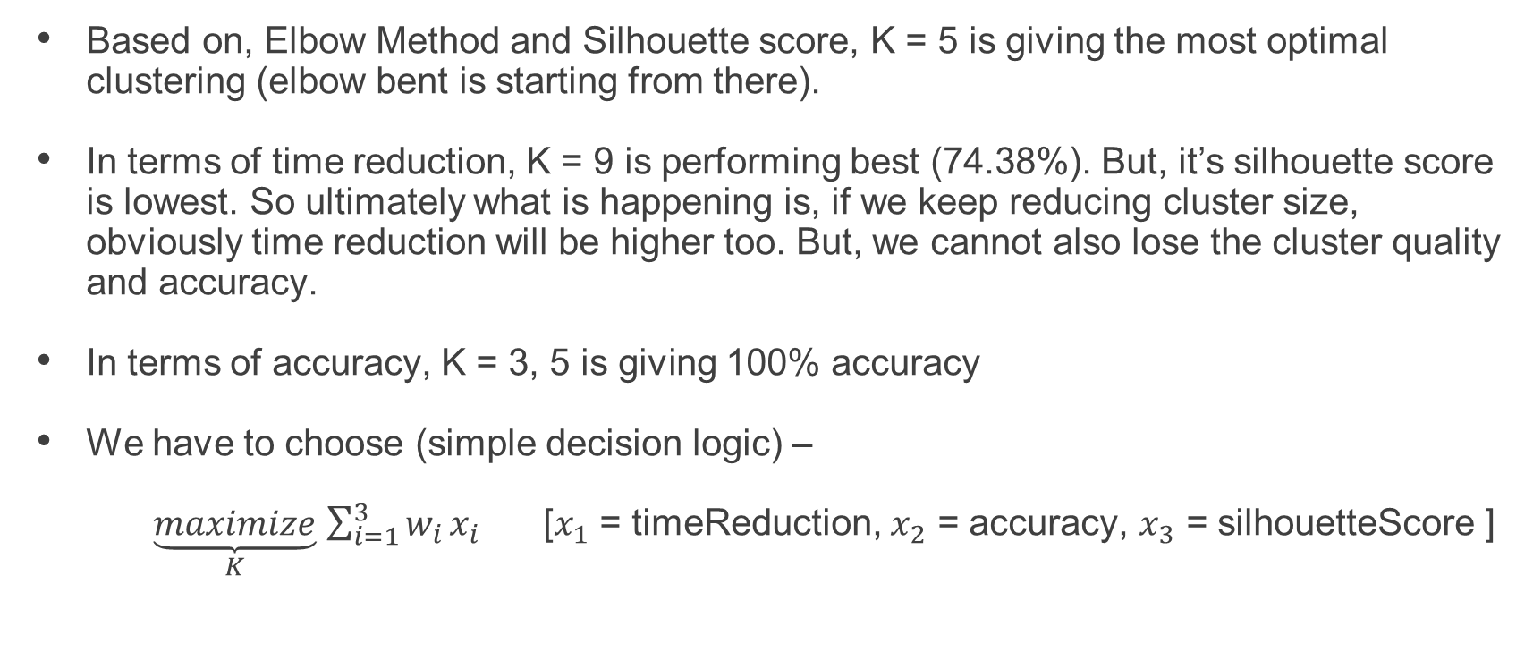
Final Decision
Based on, Elbow Method and Silhouette score, K = 5 is giving the most optimal clustering (elbow bent is starting from there).
In terms of time reduction, K = 9 is performing best (74.38%). But, it’s silhouette score is lowest. So ultimately what is happening is, if we keep reducing cluster size, obviously time reduction will be higher too. But, we cannot also lose the cluster quality and accuracy.
In terms of accuracy, K = 3, 5 is giving 100% accuracy
We have to choose (simple decision logic) –
$\underset{K}{\underbrace{maximize}}$ $\sum_{i=1}^{3}{w_{i}}x_{i}$ [$x_{1}$ = timeReduction, $x_{2}$ = accuracy, $x_{3}$ = silhouetteScore ]

Slide 42
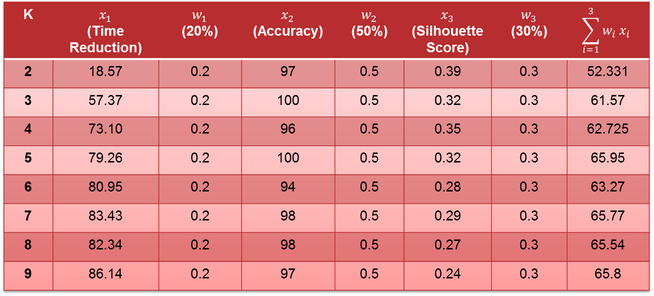
Final Decision
K | $x_{1}$ (Time Reduction) | $w_{1}$ (20%) | $x_{2}$ (Accuracy) | $w_{2}$ (50%) | $x_{3}$ (Silhouette Score) | $w_{3}$ (30%) | $$\sum_{i=1}^{3}{w_{i}}x_{i}$$
2 | 18.57 | 0.2 | 97 | 0.5 | 0.39 | 0.3 | 52.331
3 | 57.37 | 0.2 | 100 | 0.5 | 0.32 | 0.3 | 61.57
4 | 73.10 | 0.2 | 96 | 0.5 | 0.35 | 0.3 | 62.725
5 | 79.26 | 0.2 | 100 | 0.5 | 0.32 | 0.3 | 65.95
6 | 80.95 | 0.2 | 94 | 0.5 | 0.28 | 0.3 | 63.27
7 | 83.43 | 0.2 | 98 | 0.5 | 0.29 | 0.3 | 65.77
8 | 82.34 | 0.2 | 98 | 0.5 | 0.27 | 0.3 | 65.54
9 | 86.14 | 0.2 | 97 | 0.5 | 0.24 | 0.3 | 65.8
Choose K = 5 for this Dataset

Slide 43
Final Remarks and yet to include in this project
Our preliminary analysis shows promising results in case of time reduction (79.26%)
Run full simulation on the 1 Million ECG ViEW Dataset and get more analysis (Problematic due to lack of proper hardware - GPU)
Also we need to find out FAR / FRR ratio as another performance metric.

Slide 44
Future Work
Apply PCA for dimensionality reduction which will reduce more time as template size will degrade

Slide 45
References
Faster person identification using compressed ECG in time critical wireless telecardiology applications, Sufi et. al. , Journal of Network and Computer Applications, Volume 34, Issue 1, January 2011, Pages 282-293
Fiducial feature reduction analysis for electrocardiogram (ECG) based biometric recognition, Tantawi et. Al. , Journal of Intelligent Information Systems, Volume 40, Issue 1, Pages 17-39

Slide 46
Thank You

